Slide 1

Database Management Systems CS 5200
Rached Zantout
Announcements:
Online Office Hours Link.
Name Tents

Slide 2
Plan for Today
Module 3: Chapter 03 Part 2 of 2 (75 minutes)
Database System Concepts and Architecture - Continued
Discussion (15 minutes)
Class Activity: Create an ER Diagram for a Case Study
Assign Homework 02
Break (20 minutes)
Module 3: Chapter 04 (75 minutes)
Enhanced ER Model
Discussion (10 minutes)
Class Activity: EER diagram for a Library Inventory management system.
Assign Lab 02: ER Modeling
Review Deliverables (5 minutes)

Slide 3
CHAPTER 3 - continued
Data Modeling Using the Entity-Relationship (ER) Model

Slide 4
Chapter Outline
Overview of Database Design Process
Example Database Application (COMPANY)
ER Model Concepts
Entities and Attributes
Entity Types, Value Sets, and Key Attributes
Relationships and Relationship Types
Weak Entity Types
Roles and Attributes in Relationship Types
ER Diagrams - Notation
ER Diagram for COMPANY Schema
Alternative Notations – UML class diagrams, others
Relationships of Higher Degree

Slide 5
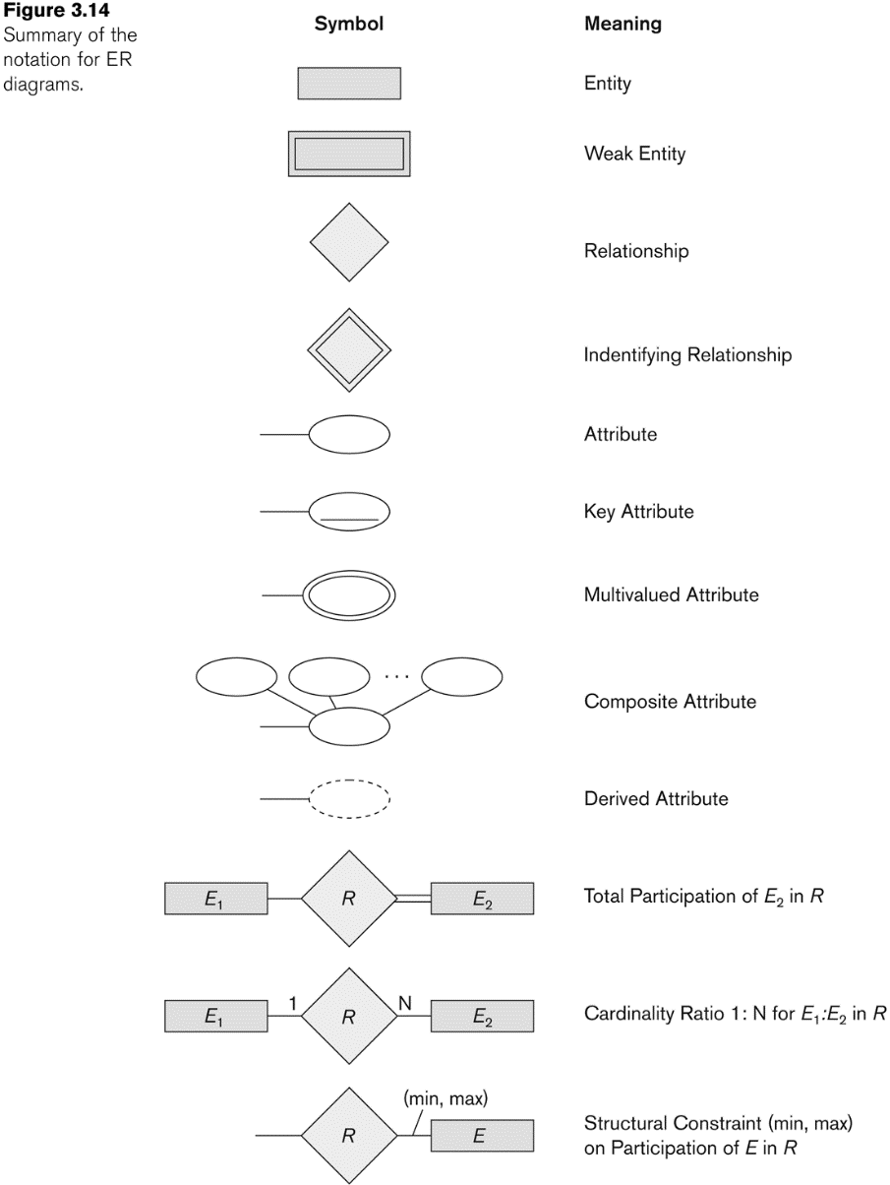
NOTATION for ER diagrams

Slide 6
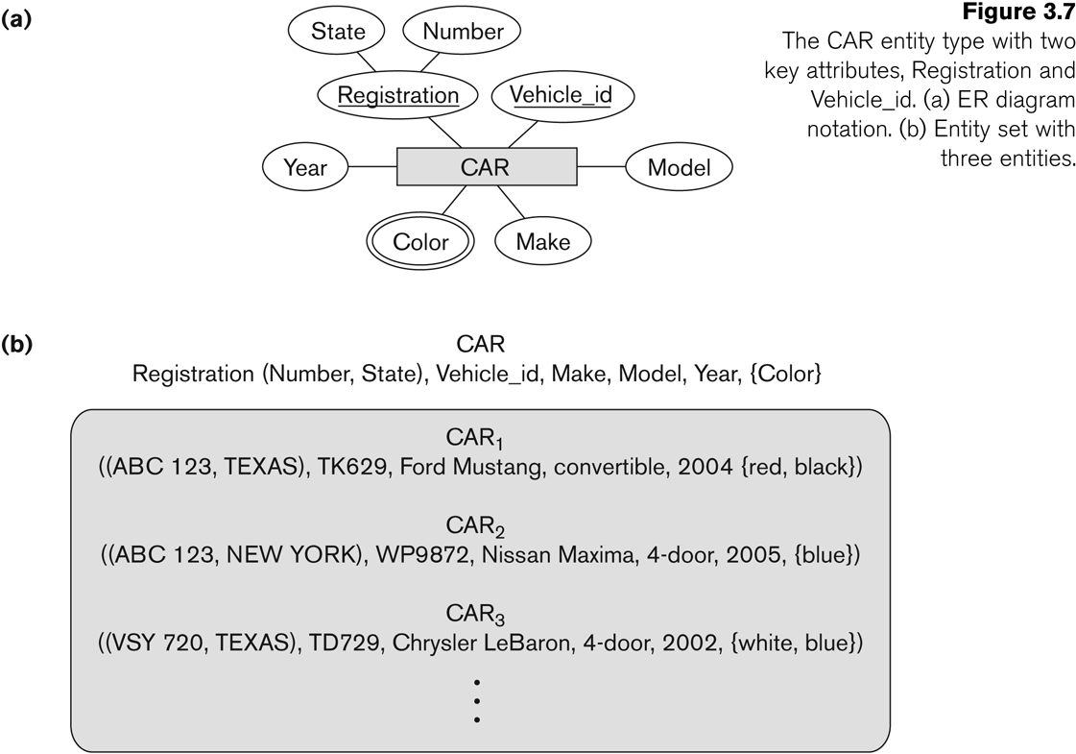
Entity Type CAR with two keys and a corresponding Entity Set

Slide 7
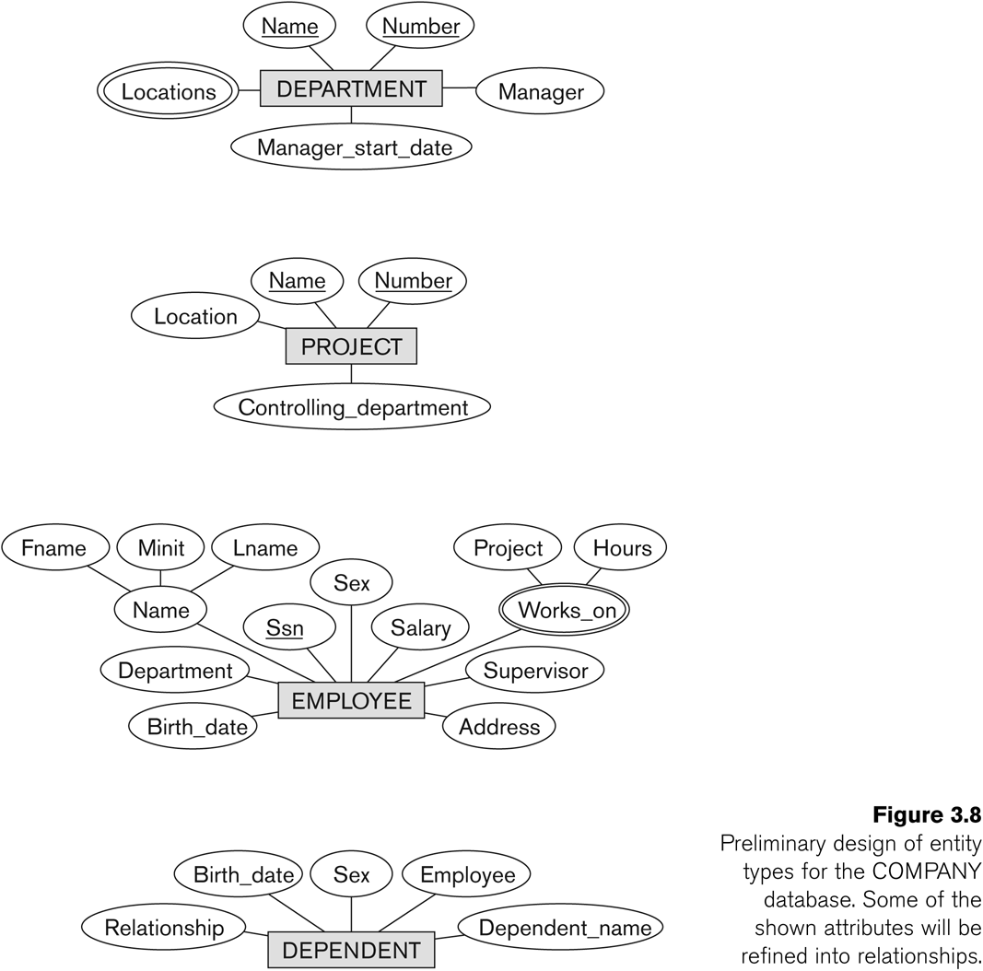
Initial Design of Entity Types EMPLOYEE, DEPARTMENT, PROJECT, DEPENDENT

Slide 8
Refining the initial design by introducing relationships
The initial design is typically not complete
Some aspects in the requirements will be represented as relationships
ER model has three main concepts:
Entities (and their entity types and entity sets)
Attributes (simple, composite, multivalued)
Relationships (and their relationship types and relationship sets)
We introduce relationship concepts next

Slide 9
Relationships and Relationship Types (1)
A relationship relates two or more distinct entities with a specific meaning.
For example, EMPLOYEE John Smith works on the ProductX PROJECT, or EMPLOYEE Franklin Wong manages the Research DEPARTMENT.
Relationships of the same type are grouped or typed into a relationship type.
For example, the WORKS_ON relationship type in which EMPLOYEEs and PROJECTs participate, or the MANAGES relationship type in which EMPLOYEEs and DEPARTMENTs participate.
The degree of a relationship type is the number of participating entity types.
Both MANAGES and WORKS_ON are binary relationships.

Slide 10
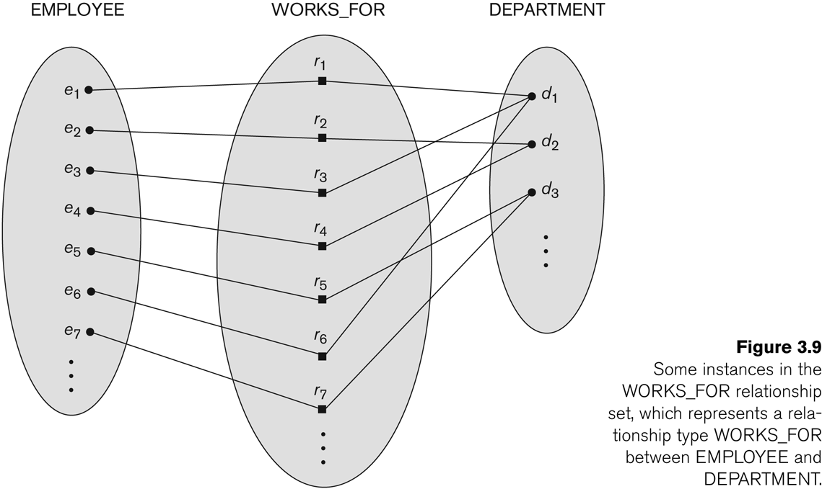
Relationship instances of the WORKS_FOR N:1 relationship between EMPLOYEE and DEPARTMENT

Slide 11
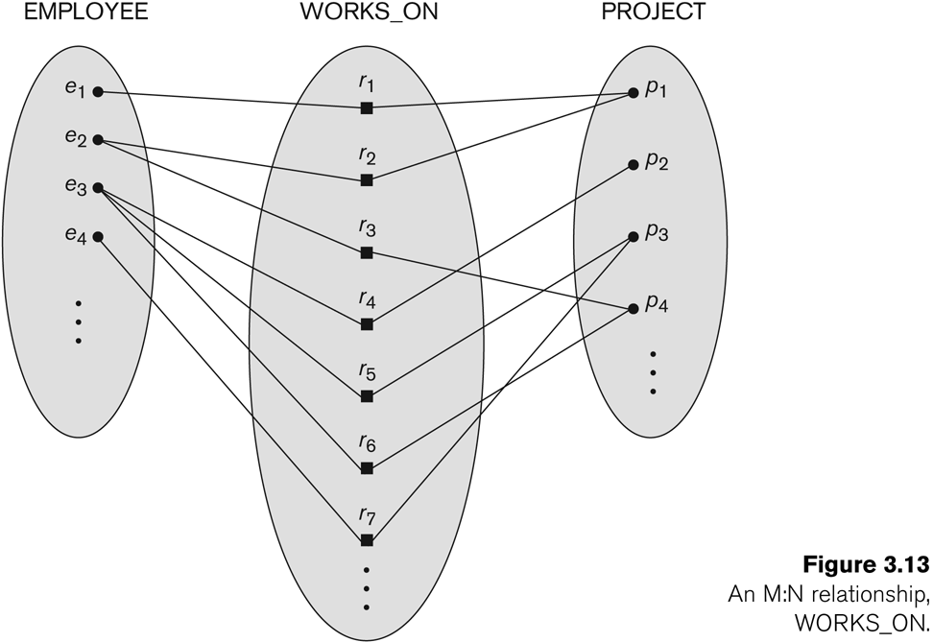
Relationship instances of the M:N WORKS_ON relationship between EMPLOYEE and PROJECT

Slide 12
Relationship type vs. relationship set (1)
Relationship Type:
Is the schema description of a relationship
Identifies the relationship name and the participating entity types
Also identifies certain relationship constraints
Relationship Set:
The current set of relationship instances represented in the database
The current state of a relationship type

Slide 13
Relationship type vs. relationship set (2)
Previous figures displayed the relationship sets
Each instance in the set relates individual participating entities – one from each participating entity type
In ER diagrams, we represent the relationship type as follows:
Diamond-shaped box is used to display a relationship type
Connected to the participating entity types via straight lines
Note that the relationship type is not shown with an arrow. The name should be typically be readable from left to right and top to bottom.

Slide 14
Refining the COMPANY database schema by introducing relationships
By examining the requirements, six relationship types are identified
All are binary relationships( degree 2)
Listed below with their participating entity types:
WORKS_FOR (between EMPLOYEE, DEPARTMENT)
MANAGES (also between EMPLOYEE, DEPARTMENT)
CONTROLS (between DEPARTMENT, PROJECT)
WORKS_ON (between EMPLOYEE, PROJECT)
SUPERVISION (between EMPLOYEE (as subordinate), EMPLOYEE (as supervisor))
DEPENDENTS_OF (between EMPLOYEE, DEPENDENT)

Slide 15
Initial Design of Entity Types EMPLOYEE, DEPARTMENT, PROJECT, DEPENDENT

Slide 16
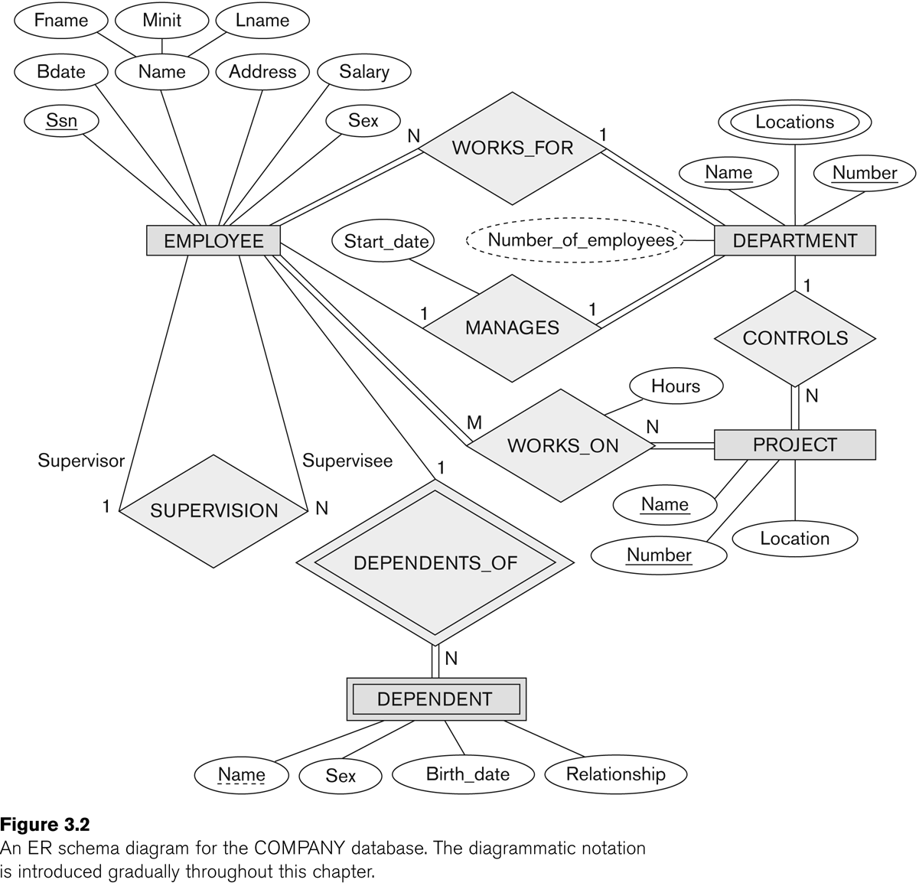
ER DIAGRAM – Relationship Types are: WORKS_FOR, MANAGES, WORKS_ON, CONTROLS, SUPERVISION, DEPENDENTS_OF

Slide 17
Discussion on Relationship Types
In the refined design, some attributes from the initial entity types are refined into relationships:
Manager of DEPARTMENT -> MANAGES
Works_on of EMPLOYEE -> WORKS_ON
Department of EMPLOYEE -> WORKS_FOR
etc
In general, more than one relationship type can exist between the same participating entity types
MANAGES and WORKS_FOR are distinct relationship types between EMPLOYEE and DEPARTMENT
Different meanings and different relationship instances.

Slide 18
Constraints on Relationships
Constraints on Relationship Types
(Also known as ratio constraints)
Cardinality Ratio (specifies maximum participation)
One-to-one (1:1)
One-to-many (1:N) or Many-to-one (N:1)
Many-to-many (M:N)
Existence Dependency Constraint (specifies minimum participation) (also called participation constraint)
zero (optional participation, not existence-dependent)
one or more (mandatory participation, existence-dependent)

Slide 19
Many-to-one (N:1) Relationship

Slide 20
Many-to-many (M:N) Relationship

Slide 21
Recursive Relationship Type
A relationship type between the same participating entity type in distinct roles
Also called a self-referencing relationship type.
Example: the SUPERVISION relationship
EMPLOYEE participates twice in two distinct roles:
supervisor (or boss) role
supervisee (or subordinate) role
Each relationship instance relates two distinct EMPLOYEE entities:
One employee in supervisor role
One employee in supervisee role

Slide 22
Displaying a recursive relationship
In a recursive relationship type.
Both participations are same entity type in different roles.
For example, SUPERVISION relationships between EMPLOYEE (in role of supervisor or boss) and (another) EMPLOYEE (in role of subordinate or worker).
In following figure, first role participation labeled with 1 and second role participation labeled with 2.
In ER diagram, need to display role names to distinguish participations.

Slide 23
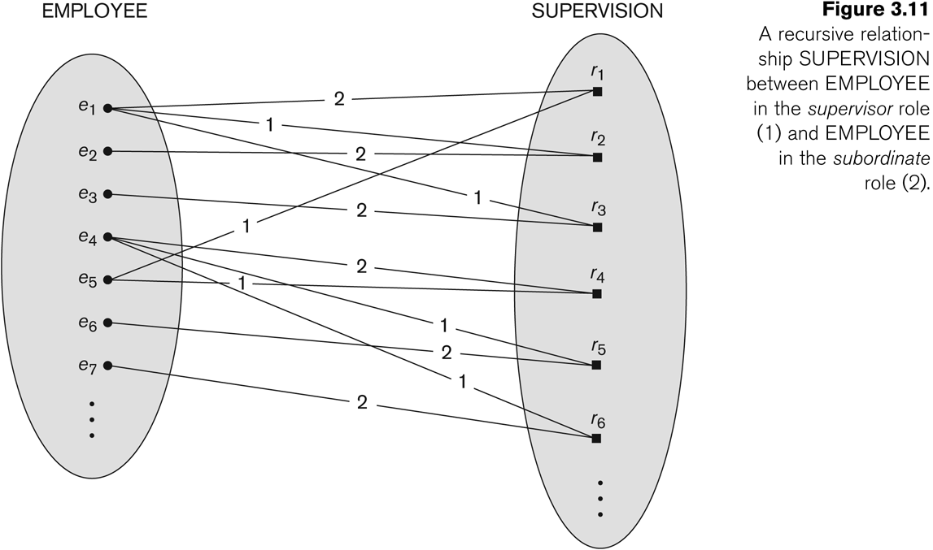
A Recursive Relationship Supervision`

Slide 24
Recursive Relationship Type is: SUPERVISION (participation role names are shown)

Slide 25
Weak Entity Types
An entity that does not have a key attribute and that is identification-dependent on another entity type.
A weak entity must participate in an identifying relationship type with an owner or identifying entity type
Entities are identified by the combination of:
A partial key of the weak entity type
The particular entity they are related to in the identifying relationship type
Example:
A DEPENDENT entity is identified by the dependent’s first name, and the specific EMPLOYEE with whom the dependent is related
Name of DEPENDENT is the partial key
DEPENDENT is a weak entity type
EMPLOYEE is its identifying entity type via the identifying relationship type DEPENDENT_OF

Slide 26
Attributes of Relationship types
A relationship type can have attributes:
For example, HoursPerWeek of WORKS_ON
Its value for each relationship instance describes the number of hours per week that an EMPLOYEE works on a PROJECT.
A value of HoursPerWeek depends on a particular (employee, project) combination
Most relationship attributes are used with M:N relationships
In 1:N relationships, they can be transferred to the entity type on the N-side of the relationship

Slide 27
Example Attribute of a Relationship Type: Hours of WORKS_ON

Slide 28
Notation for Constraints on Relationships
Cardinality ratio (of a binary relationship): 1:1, 1:N, N:1, or M:N
Shown by placing appropriate numbers on the relationship edges.
Participation constraint (on each participating entity type): total (called existence dependency) or partial.
Total shown by double line, partial by single line.
NOTE: These are easy to specify for Binary Relationship Types.

Slide 29
Alternative (min, max) notation for relationship structural constraints:
Specified on each participation of an entity type E in a relationship type R
Specifies that each entity e in E participates in at least min and at most max relationship instances in R
Default(no constraint): min=0, max=n (signifying no limit)
Must have min≤max, min≥0, max ≥1
Derived from the knowledge of mini-world constraints
Examples:
A department has exactly one manager and an employee can manage at most one department.
Specify (0,1) for participation of EMPLOYEE in MANAGES
Specify (1,1) for participation of DEPARTMENT in MANAGES
An employee can work for exactly one department but a department can have any number of employees.
Specify (1,1) for participation of EMPLOYEE in WORKS_FOR
Specify (0,n) for participation of DEPARTMENT in WORKS_FOR

Slide 30
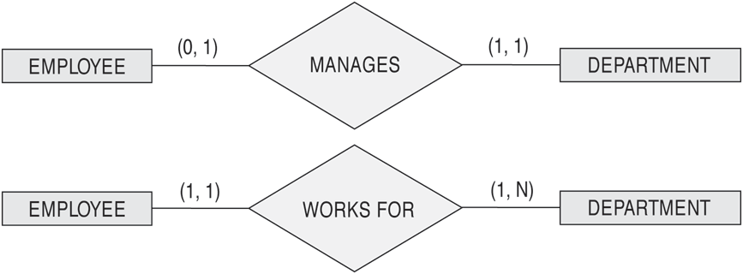
The (min,max) notation for relationship constraints
Read the min,max numbers next to the entity type and looking away from the entity type

Slide 31
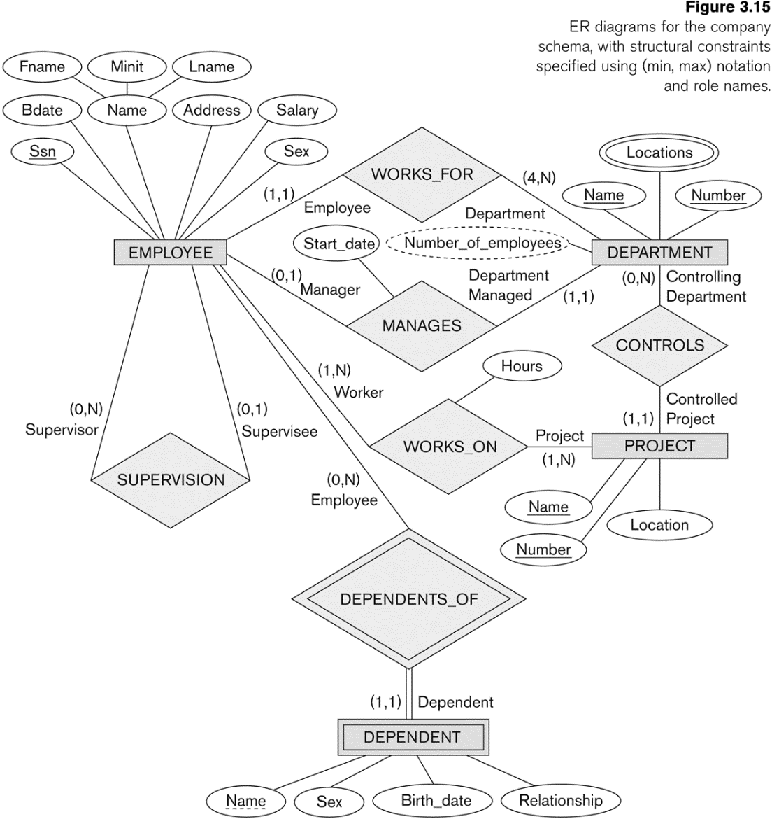
COMPANY ER Schema Diagram using (min, max) notation

Slide 32
Is it 4:15 yet?

Slide 33
Alternative diagrammatic notation
ER diagrams is one popular example for displaying database schemas
Many other notations exist in the literature and in various database design and modeling tools
Appendix A illustrates some of the alternative notations that have been used
UML class diagrams is representative of another way of displaying ER concepts that is used in several commercial design tools

Slide 34
Summary of notation for ER diagrams

Slide 35
UML class diagrams
Represent classes (similar to entity types) as large rounded boxes with three sections:
Top section includes entity type (class) name
Second section includes attributes
Third section includes class operations (operations are not in basic ER model)
Relationships (called associations) represented as lines connecting the classes
Other UML terminology also differs from ER terminology
Used in database design and object-oriented software design
UML has many other types of diagrams for software design

Slide 36
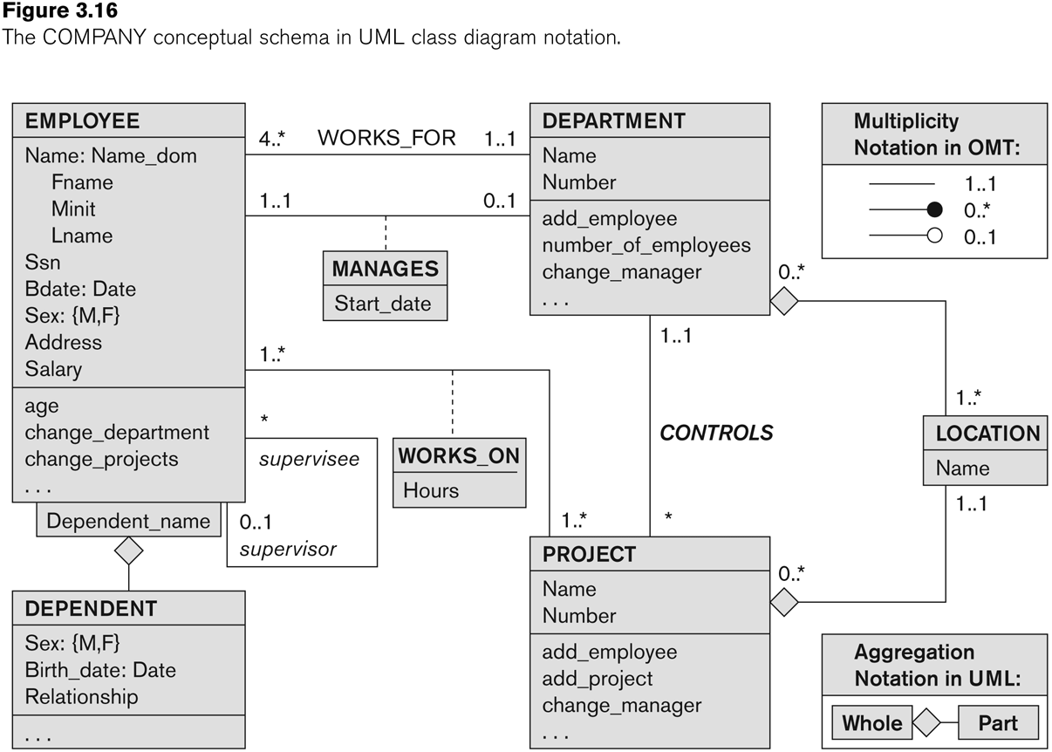
UML class diagram for COMPANY database schema

Slide 37
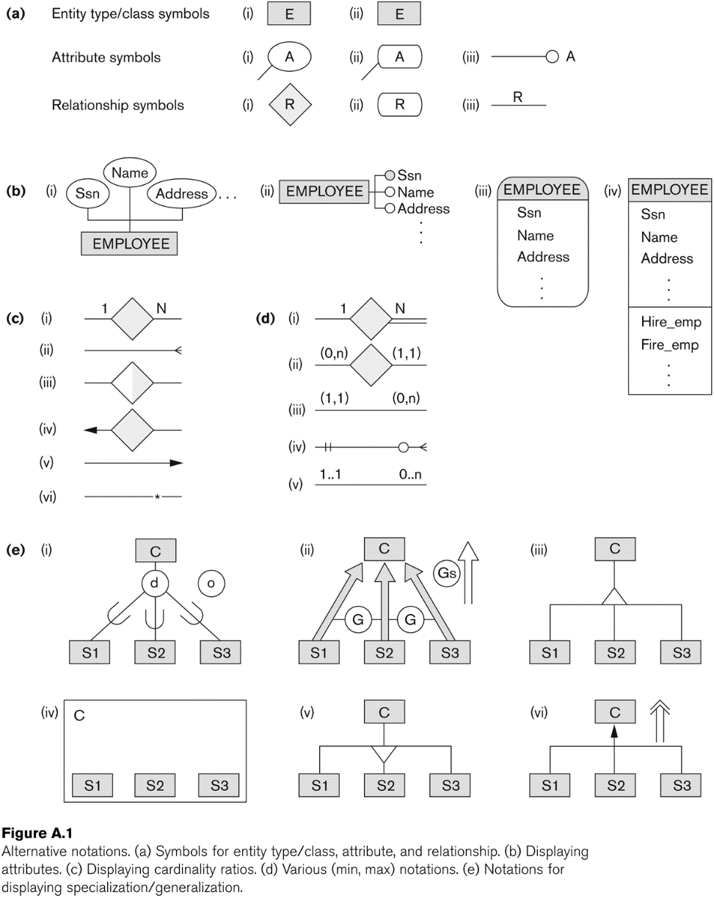
Other alternative diagrammatic notations

Slide 38
Relationships of Higher Degree
Relationship types of degree 2 are called binary
Relationship types of degree 3 are called ternary and of degree n are called n-ary
In general, an n-ary relationship is not equivalent to n binary relationships
Constraints are harder to specify for higher-degree relationships (n > 2) than for binary relationships

Slide 39
Discussion of n-ary relationships (n > 2)
In general, 3 binary relationships can represent different information than a single ternary relationship (see Figure 3.17a and b on next slide)
If needed, the binary and n-ary relationships can all be included in the schema design (see Figure 3.17a and b, where all relationships convey different meanings)
In some cases, a ternary relationship can be represented as a weak entity if the data model allows a weak entity type to have multiple identifying relationships (and hence multiple owner entity types) (see Figure 3.17c)

Slide 40
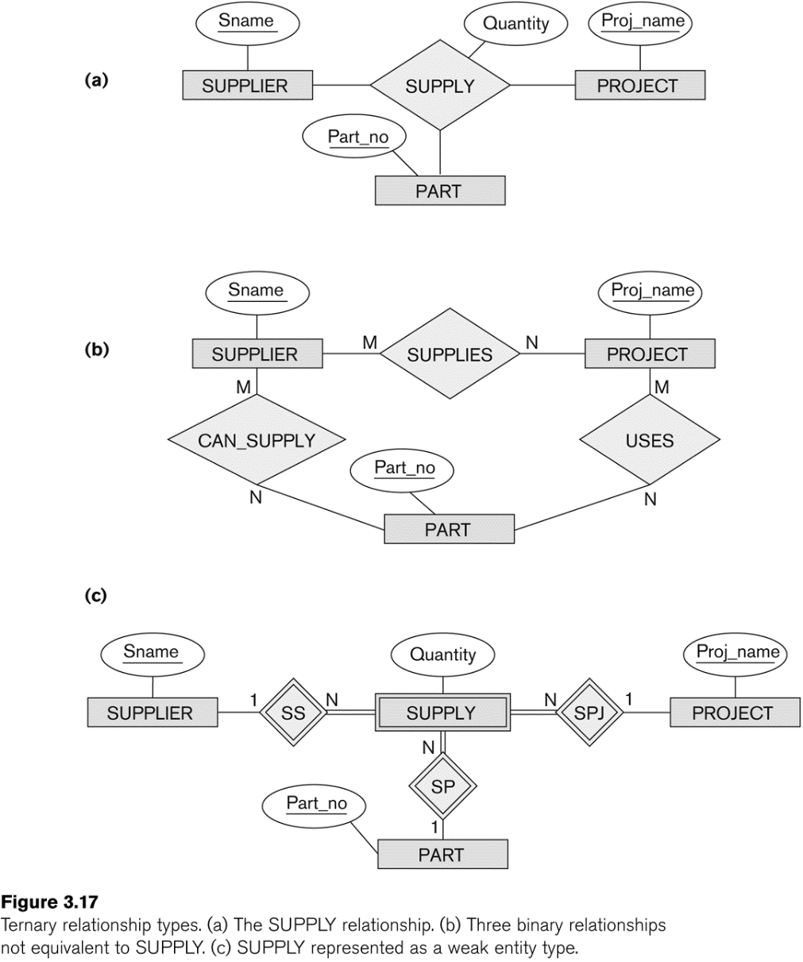
Example of a ternary relationship

Slide 41
Discussion of n-ary relationships (n > 2)
If a particular binary relationship can be derived from a higher-degree relationship at all times, then it is redundant
For example, the TAUGHT_DURING binary relationship in Figure 3.18 (see next slide) can be derived from the ternary relationship OFFERS (based on the meaning of the relationships)

Slide 42
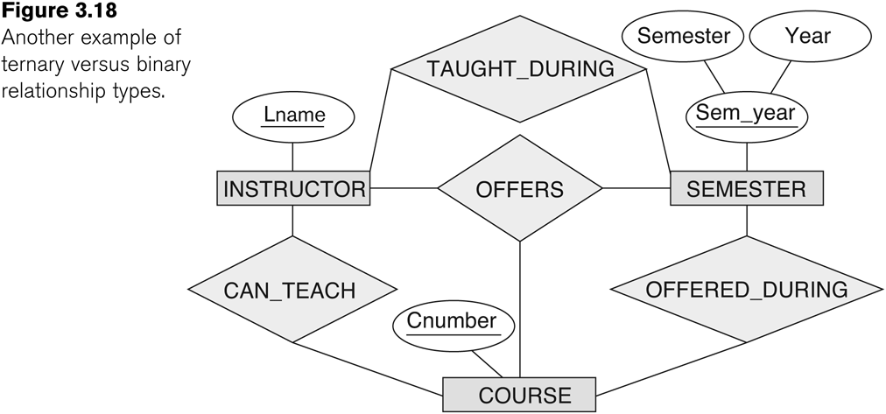
Another example of a ternary relationship

Slide 43
Displaying constraints on higher-degree relationships
The (min, max) constraints can be displayed on the edges – however, they do not fully describe the constraints
Displaying a 1, M, or N indicates additional constraints
An M or N indicates no constraint
A 1 indicates that an entity can participate in at most one relationship instance that has a particular combination of the other participating entities
In general, both (min, max) and 1, M, or N are needed to describe fully the constraints
Overall, the constraint specification is difficult and possibly ambiguous when we consider relationships of a degree higher than two.

Slide 44
Another Example: A UNIVERSITY Database
To keep track of the enrollments in classes and student grades, another database is to be designed.
It keeps track of the COLLEGEs, DEPARTMENTs within each college, the COURSEs offered by departments, and SECTIONs of courses, INSTRUCTORs who teach the sections etc.
These entity types and the relationships among these entity types are shown on the next slide in Figure 3.20.

Slide 45

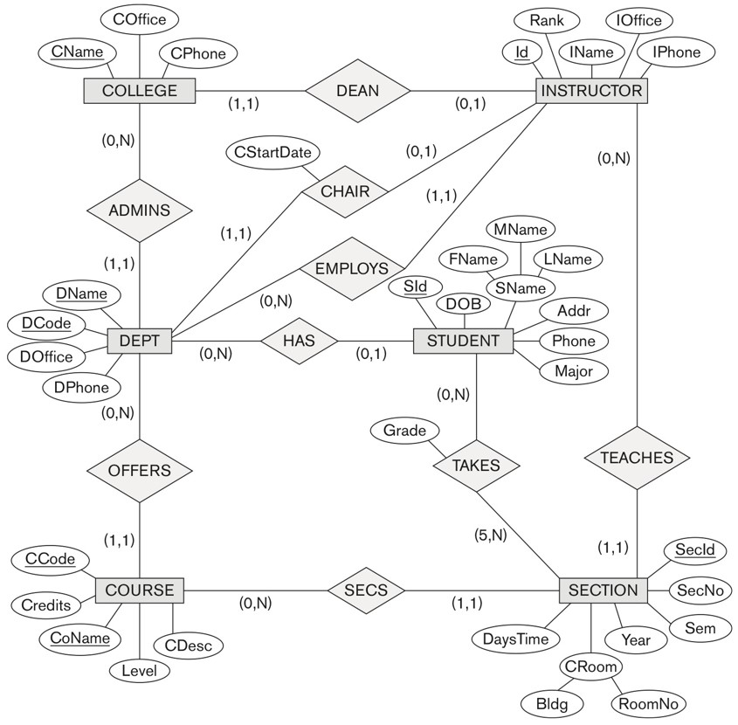
UNIVERSITY database conceptual schema

Slide 46
Chapter Summary
ER Model Concepts: Entities, attributes, relationships
Constraints in the ER model
Using ER in step-by-step mode conceptual schema design for the COMPANY database
ER Diagrams - Notation
Alternative Notations – UML class diagrams, others
Binary Relationship types and those of higher degree.

Slide 47
Data Modeling Tools (Additional Material )
A number of popular tools that cover conceptual modeling and mapping into relational schema design.
Examples: ERWin, S- Designer (Enterprise Application Suite), ER- Studio, etc.
POSITIVES:
Serves as documentation of application requirements, easy user interface - mostly graphics editor support
NEGATIVES:
Most tools lack a proper distinct notation for relationships with relationship attributes
Mostly represent a relational design in a diagrammatic form rather than a conceptual ER-based design

Slide 48
Some of the Automated Database Design Tools (Note: Not all may be on the market now)
COMPANY | TOOL | FUNCTIONALITY
Embarcadero Technologies | ER Studio | Database Modeling in ER and IDEF1X
 | DB Artisan | Database administration, space and security management
Oracle | Developer 2000/Designer 2000 | Database modeling, application development
Popkin Software | System Architect 2001 | Data modeling, object modeling, process modeling, structured analysis/design
Platinum (Computer Associates) | Enterprise Modeling Suite: Erwin, BPWin, Paradigm Plus | Data, process, and business component modeling
Persistence Inc. | Pwertier | Mapping from O-O to relational model
Rational (IBM) | Rational Rose | UML Modeling & application generation in C++/JAVA
Resolution Ltd. | Xcase | Conceptual modeling up to code maintenance
Sybase | Enterprise Application Suite | Data modeling, business logic modeling
Visio | Visio Enterprise | Data modeling, design/reengineering Visual Basic/C++

Slide 49
Extended Entity-Relationship (EER) Model (in the next chapter)
The entity relationship model in its original form did not support the specialization and generalization abstractions
Next chapter illustrates how the ER model can be extended with
Type-subtype and set-subset relationships
Specialization/Generalization Hierarchies
Notation to display them in EER diagrams

Slide 50
Discussion 4: ER Diagram for Pet Adoption Center
Go to Canvas Discussion 4
You have been hired as a database consultant to design a database for a pet adoption center. The center needs a system to manage its animals and the adoption process.
The pet adoption center has various animals available for adoption. Each animal has a unique ID and information such as name, species, breed, age, and health status.
The center also records information about adopters. Each adopter has a unique adopter ID, and the center keeps track of their name, address, phone number, and email.
When an animal is adopted, the system needs to record which adopter adopted which animal and the adoption date. Each animal can only be adopted by one adopter, but an adopter can adopt multiple animals.
Instructions:
Identify the entities, their attributes, along with primary key, relationships between the entities and
draw a (Hand Written) Entity-Relationship (ER) diagram that includes all identified entities, their attributes, and relationships. Use appropriate symbols for entities, attributes, and relationships. Determine if there are any weak entities and their identifying relationships.

Slide 51
Break (4:30 PM – 4:50 PM) Please be punctual in returning so that we restart on time

Slide 52
CHAPTER 4
Enhanced Entity-Relationship (EER) Modeling

Slide 53
Chapter Outline
EER stands for Enhanced ER or Extended ER
EER Model Concepts
Includes all modeling concepts of basic ER
Additional concepts:
subclasses/superclasses
specialization/generalization
categories (UNION types)
attribute and relationship inheritance
Constraints on Specialization/Generalization
The additional EER concepts are used to model applications more completely and more accurately
EER includes some object-oriented concepts, such as inheritance
Knowledge Representation and Ontology Concepts

Slide 54
Subclasses and Superclasses (1)
An entity type may have additional meaningful subgroupings of its entities
Example: EMPLOYEE may be further grouped into:
SECRETARY, ENGINEER, TECHNICIAN, …
Based on the EMPLOYEE’s Job
MANAGER
EMPLOYEEs who are managers (the role they play)
SALARIED_EMPLOYEE, HOURLY_EMPLOYEE
Based on the EMPLOYEE’s method of pay
EER diagrams extend ER diagrams to represent these additional subgroupings, called subclasses or subtypes

Slide 55
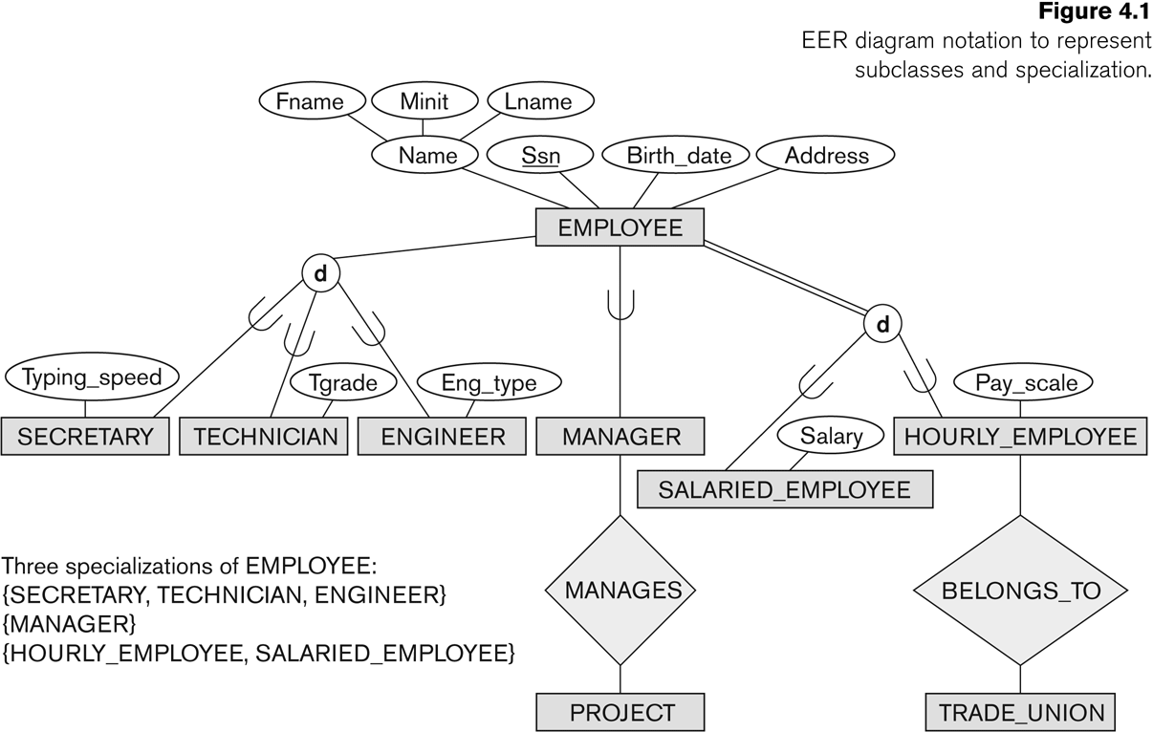
Subclasses and Superclasses

Slide 56
Subclasses and Superclasses (2)
Each of these subgroupings is a subset of EMPLOYEE entities
Each is called a subclass of EMPLOYEE
EMPLOYEE is the superclass for each of these subclasses
These are called superclass/subclass relationships:
EMPLOYEE/SECRETARY
EMPLOYEE/TECHNICIAN
EMPLOYEE/MANAGER
…

Slide 57
Subclasses and Superclasses (3)
These are also called IS-A relationships
SECRETARY IS-A EMPLOYEE, TECHNICIAN IS-A EMPLOYEE, ….
Note: An entity that is member of a subclass represents the same real-world entity as some member of the superclass:
The subclass member is the same entity in a distinct specific role
An entity cannot exist in the database merely by being a member of a subclass; it must also be a member of the superclass
A member of the superclass can be optionally included as a member of any number of its subclasses

Slide 58
Subclasses and Superclasses (4)
Examples:
A salaried employee who is also an engineer belongs to the two subclasses:
ENGINEER, and
SALARIED_EMPLOYEE
A salaried employee who is also an engineering manager belongs to the three subclasses:
MANAGER,
ENGINEER, and
SALARIED_EMPLOYEE
It is not necessary that every entity in a superclass be a member of some subclass

Slide 59
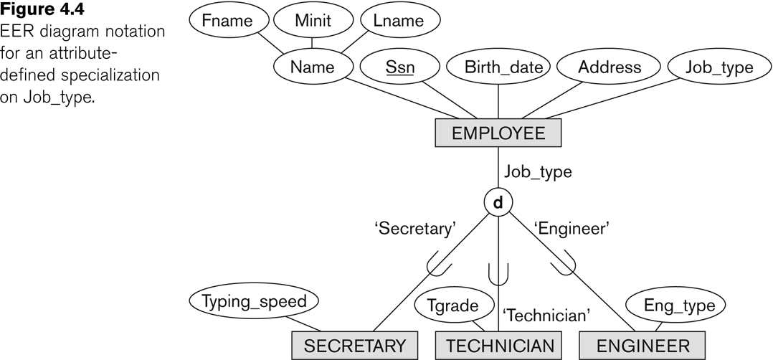
Representing Specialization in EER Diagrams

Slide 60
Attribute Inheritance in Superclass / Subclass Relationships
An entity that is member of a subclass inherits
All attributes of the entity as a member of the superclass
All relationships of the entity as a member of the superclass
Example:
In the previous slide, SECRETARY (as well as TECHNICIAN and ENGINEER) inherit the attributes Name, SSN, …, from EMPLOYEE
Every SECRETARY entity will have values for the inherited attributes

Slide 61
Specialization (1)
Specialization is the process of defining a set of subclasses of a superclass
The set of subclasses is based upon some distinguishing characteristics of the entities in the superclass
Example: {SECRETARY, ENGINEER, TECHNICIAN} is a specialization of EMPLOYEE based upon job type.
Example: MANAGER is a specialization of EMPLOYEE based on the role the employee plays
May have several specializations of the same superclass

Slide 62
Specialization (2)
Example: Another specialization of EMPLOYEE based on method of pay is {SALARIED_EMPLOYEE, HOURLY_EMPLOYEE}.
Superclass/subclass relationships and specialization can be diagrammatically represented in EER diagrams
Attributes of a subclass are called specific or local attributes.
For example, the attribute TypingSpeed of SECRETARY
The subclass can also participate in specific relationship types.
For example, a relationship BELONGS_TO of HOURLY_EMPLOYEE

Slide 63
Specialization (3)

Slide 64
Generalization
Generalization is the reverse of the specialization process
Several classes with common features are generalized into a superclass;
original classes become its subclasses
Example: CAR, TRUCK generalized into VEHICLE;
both CAR, TRUCK become subclasses of the superclass VEHICLE.
We can view {CAR, TRUCK} as a specialization of VEHICLE
Alternatively, we can view VEHICLE as a generalization of CAR and TRUCK

Slide 65
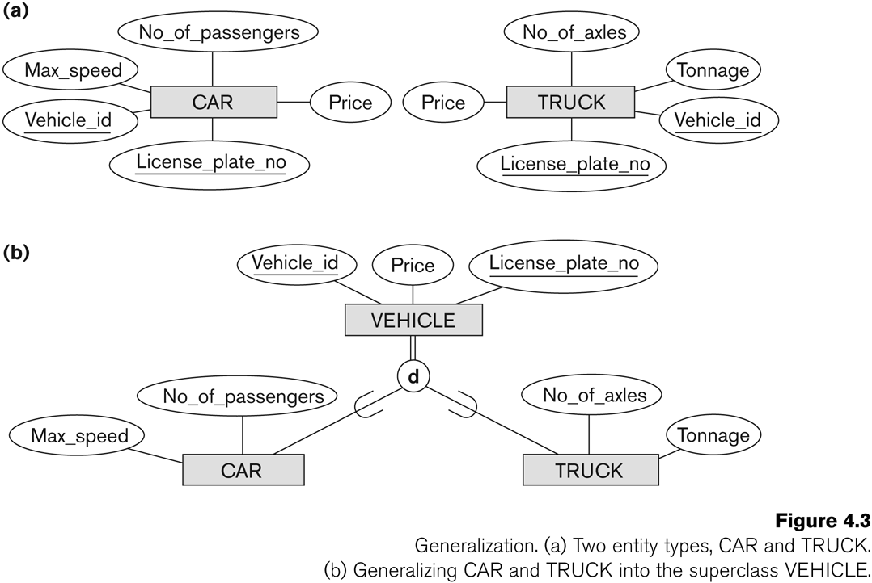
Generalization (2)

Slide 66
Generalization and Specialization (1)
Diagrammatic notations are sometimes used to distinguish between generalization and specialization
Arrow pointing to the generalized superclass represents a generalization
Arrows pointing to the specialized subclasses represent a specialization
We do not use this notation because it is often subjective as to which process is more appropriate for a particular situation
We advocate not drawing any arrows

Slide 67
Generalization and Specialization (2)
Data Modeling with Specialization and Generalization
A superclass or subclass represents a collection (or set or grouping) of entities
It also represents a particular type of entity
Shown in rectangles in EER diagrams (as are entity types)
We can call all entity types (and their corresponding collections) classes, whether they are entity types, superclasses, or subclasses

Slide 68
Types of Specialization
Predicate-defined ( or condition-defined) : based on some predicate. E.g., based on value of an attribute, say, Job-type, or Age.
Attribute-defined: shows the name of the attribute next to the line drawn from the superclass toward the subclasses (see Fig. 4.4)
User-defined: membership is defined by the user on an entity by entity basis

Slide 69
Constraints on Specialization and Generalization (1)
If we can determine exactly those entities that will become members of each subclass by a condition, the subclasses are called predicate-defined (or condition-defined) subclasses
Condition is a constraint that determines subclass members
Display a predicate-defined subclass by writing the predicate condition next to the line attaching the subclass to its superclass

Slide 70
Constraints on Specialization and Generalization (2)
If all subclasses in a specialization have membership condition on same attribute of the superclass, specialization is called an attribute-defined specialization
Attribute is called the defining attribute of the specialization
Example: JobType is the defining attribute of the specialization {SECRETARY, TECHNICIAN, ENGINEER} of EMPLOYEE
If no condition determines membership, the subclass is called user-defined
Membership in a subclass is determined by the database users by applying an operation to add an entity to the subclass
Membership in the subclass is specified individually for each entity in the superclass by the user

Slide 71
Displaying an attribute-defined specialization in EER diagrams

Slide 72
Constraints on Specialization and Generalization (3)
Two basic constraints can apply to a specialization/generalization:
Disjointness Constraint:
Completeness Constraint:

Slide 73
Constraints on Specialization and Generalization (4)
Disjointness Constraint:
Specifies that the subclasses of the specialization must be disjoint:
an entity can be a member of at most one of the subclasses of the specialization
Specified by d in EER diagram
If not disjoint, specialization is overlapping:
that is the same entity may be a member of more than one subclass of the specialization
Specified by o in EER diagram

Slide 74
Constraints on Specialization and Generalization (5)
Completeness (Exhaustiveness) Constraint:
Total specifies that every entity in the superclass must be a member of some subclass in the specialization/generalization
Shown in EER diagrams by a double line
Partial allows an entity not to belong to any of the subclasses
Shown in EER diagrams by a single line

Slide 75
Constraints on Specialization and Generalization (6)
Hence, we have four types of specialization/generalization:
Disjoint, total
Disjoint, partial
Overlapping, total
Overlapping, partial
Note: Generalization usually is total because the superclass is derived from the subclasses.

Slide 76
Example of disjoint partial Specialization

Slide 77
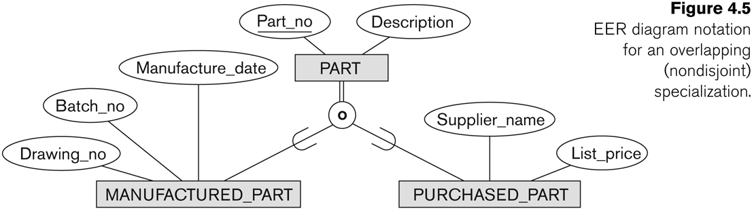
Example of overlapping total Specialization

Slide 78
Specialization/Generalization Hierarchies, Lattices & Shared Subclasses (1)
A subclass may itself have further subclasses specified on it
forms a hierarchy or a lattice
Hierarchy has a constraint that every subclass has only one superclass (called single inheritance); this is basically a tree structure
In a lattice, a subclass can be subclass of more than one superclass (called multiple inheritance)

Slide 79
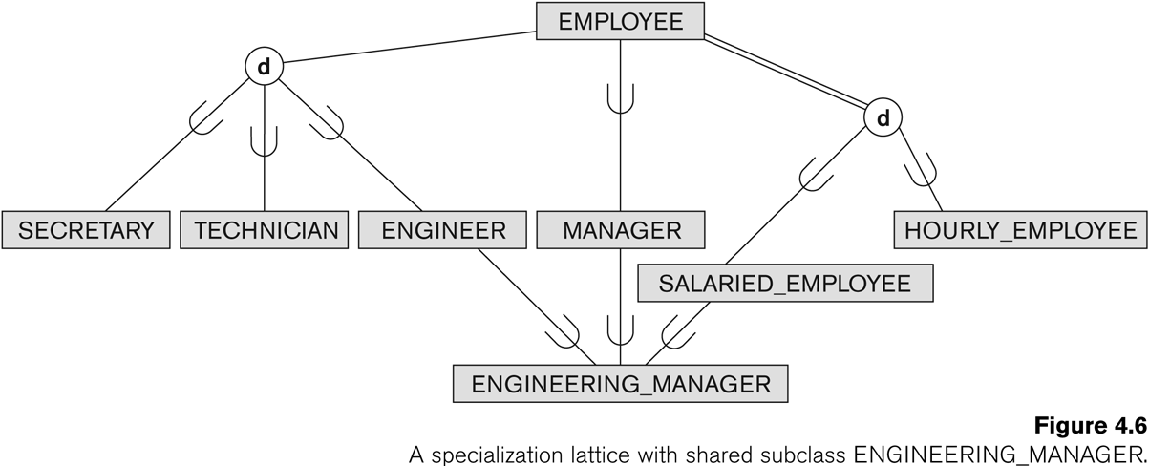
Shared Subclass “Engineering_Manager”

Slide 80
Specialization/Generalization Hierarchies, Lattices & Shared Subclasses (2)
In a lattice or hierarchy, a subclass inherits attributes not only of its direct superclass, but also of all its predecessor superclasses
A subclass with more than one superclass is called a shared subclass (multiple inheritance)
Can have:
specialization hierarchies or lattices, or
generalization hierarchies or lattices,
depending on how they were derived
We just use specialization (to stand for the end result of either specialization or generalization)

Slide 81
Specialization/Generalization Hierarchies, Lattices & Shared Subclasses (3)
In specialization, start with an entity type and then define subclasses of the entity type by successive specialization
called a top down conceptual refinement process
In generalization, start with many entity types and generalize those that have common properties
Called a bottom up conceptual synthesis process
In practice, a combination of both processes is usually employed

Slide 82
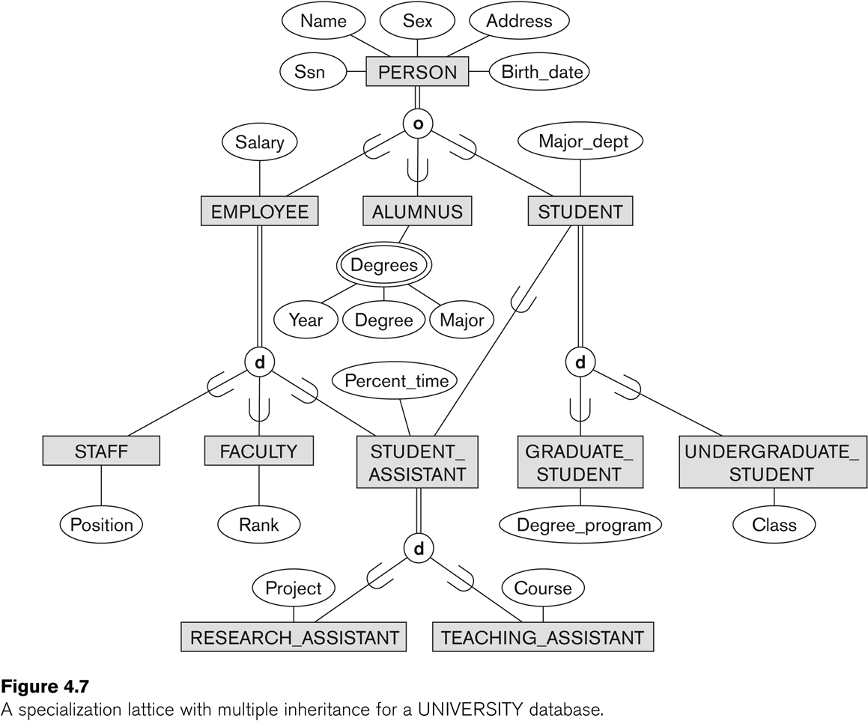
Specialization / Generalization Lattice Example (UNIVERSITY)

Slide 83
Categories (UNION TYPES) (1)
All of the superclass/subclass relationships we have seen thus far have a single superclass
A shared subclass is a subclass in:
more than one distinct superclass/subclass relationships
each relationship has a single superclass
shared subclass leads to multiple inheritance
In some cases, we need to model a single superclass/subclass relationship with more than one superclass
Superclasses can represent different entity types
Such a subclass is called a category or UNION TYPE

Slide 84
Categories (UNION TYPES) (2)
Example: In a database for vehicle registration, a vehicle owner can be a PERSON, a BANK (holding a lien on a vehicle) or a COMPANY.
A category (UNION type) called OWNER is created to represent a subset of the union of the three superclasses COMPANY, BANK, and PERSON
A category member must exist in at least one (typically just one) of its superclasses
Difference from shared subclass, which is a:
subset of the intersection of its superclasses
shared subclass member must exist in all of its superclasses

Slide 85
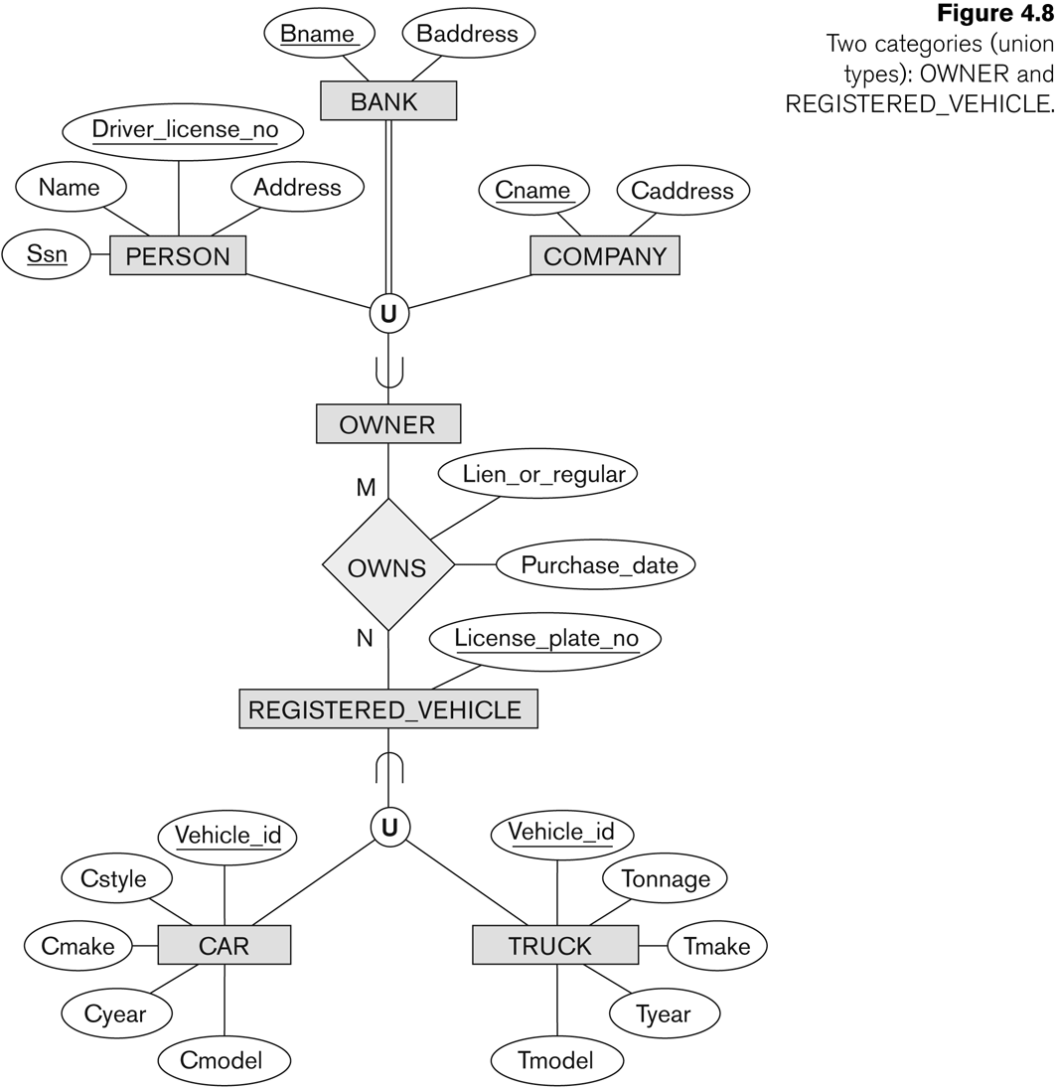
Two categories (UNION types): OWNER, REGISTERED_VEHICLE

Slide 86
Is it 6:05 yet?

Slide 87
Discussion 05 (6:05 – 6:15) EER Modeling for Library Database
A library service wants to create a database to store details of its libraries, books and borrowers. Details include the following:
A book has a unique ISBN number, a title and one or more authors.
The library service may own several copies of a given book, each of which is located in one of the service’s libraries.
A given library contains many books, and in order to distinguish different copies of the same book a library assigns a different copy-number to each of its copies of a given book; the price that was paid for each copy is also recorded.
Every library has a unique name and is either a main library or a branch library.
A main library may have zero or more branch libraries and
every branch library is a branch of exactly one main library.
A borrower has a name and a unique ID code. A borrower can have many books on loan, but each copy of a book can only be on loan to one borrower.
A borrower could borrow the same book on several occasions, but it is assumed that each such loan will take place on a different date.
Please create an Enhanced Entity Relationship diagram that captures this information about a library. Be certain to indicate identifiers and cardinality constraints.

Slide 88
Review Deliverables (6:15 – 6:20)
Discussion 04:
Should have been submitted by 4:30 PM.
Discussion 05:
Should have been submitted by 6:20 PM.
Homework 02:
Due By: Wednesday January 28, 2026 3:00 PM
Available Until: Friday January 30, 2026 3:00 PM
Lab 02:
Due By:
Available Until:

Slide 89
Formal Definitions of EER Model (1)
Class C:
A type of entity with a corresponding set of entities:
could be entity type, subclass, superclass, or category
Note: The definition of relationship type in ER/EER should have 'entity type' replaced with 'class‘ to allow relationships among classes in general
Subclass S is a class whose:
Type inherits all the attributes and relationship of a class C
Set of entities must always be a subset of the set of entities of the other class C
S ⊆ C
C is called the superclass of S
A superclass/subclass relationship exists between S and C

Slide 90
Formal Definitions of EER Model (2)
Specialization Z: Z = {S1, S2,…, Sn} is a set of subclasses with same superclass G; hence, G/Si is a superclass relationship for i = 1, …., n.
G is called a generalization of the subclasses {S1, S2,…, Sn}
Z is total if we always have:
S1 ∪ S2 ∪ … ∪ Sn = G;
Otherwise, Z is partial.
Z is disjoint if we always have:
Si ∩ Sj empty-set for i ≠ j;
Otherwise, Z is overlapping.

Slide 91
Formal Definitions of EER Model (3)
Subclass S of C is predicate defined if predicate (condition) p on attributes of C is used to specify membership in S;
that is, S = C[p], where C[p] is the set of entities in C that satisfy condition p
A subclass not defined by a predicate is called user-defined
Attribute-defined specialization: if a predicate A = ci (where A is an attribute of G and ci is a constant value from the domain of A) is used to specify membership in each subclass Si in Z
Note: If ci ≠ cj for i ≠ j, and A is single-valued, then the attribute-defined specialization will be disjoint.

Slide 92
Formal Definitions of EER Model (4)
Category or UNION type T
A class that is a subset of the union of n defining superclasses D1, D2,…Dn, n>1:
T ⊆ (D1 ∪ D2 ∪ … ∪ Dn)
Can have a predicate pi on the attributes of Di to specify entities of Di that are members of T.
If a predicate is specified on every Di: T = (D1[p1] ∪ D2[p2] ∪…∪ Dn[pn])

Slide 93
Alternative diagrammatic notations
ER/EER diagrams are a specific notation for displaying the concepts of the model diagrammatically
DB design tools use many alternative notations for the same or similar concepts
One popular alternative notation uses UML class diagrams
see next slides for UML class diagrams and other alternative notations

Slide 94
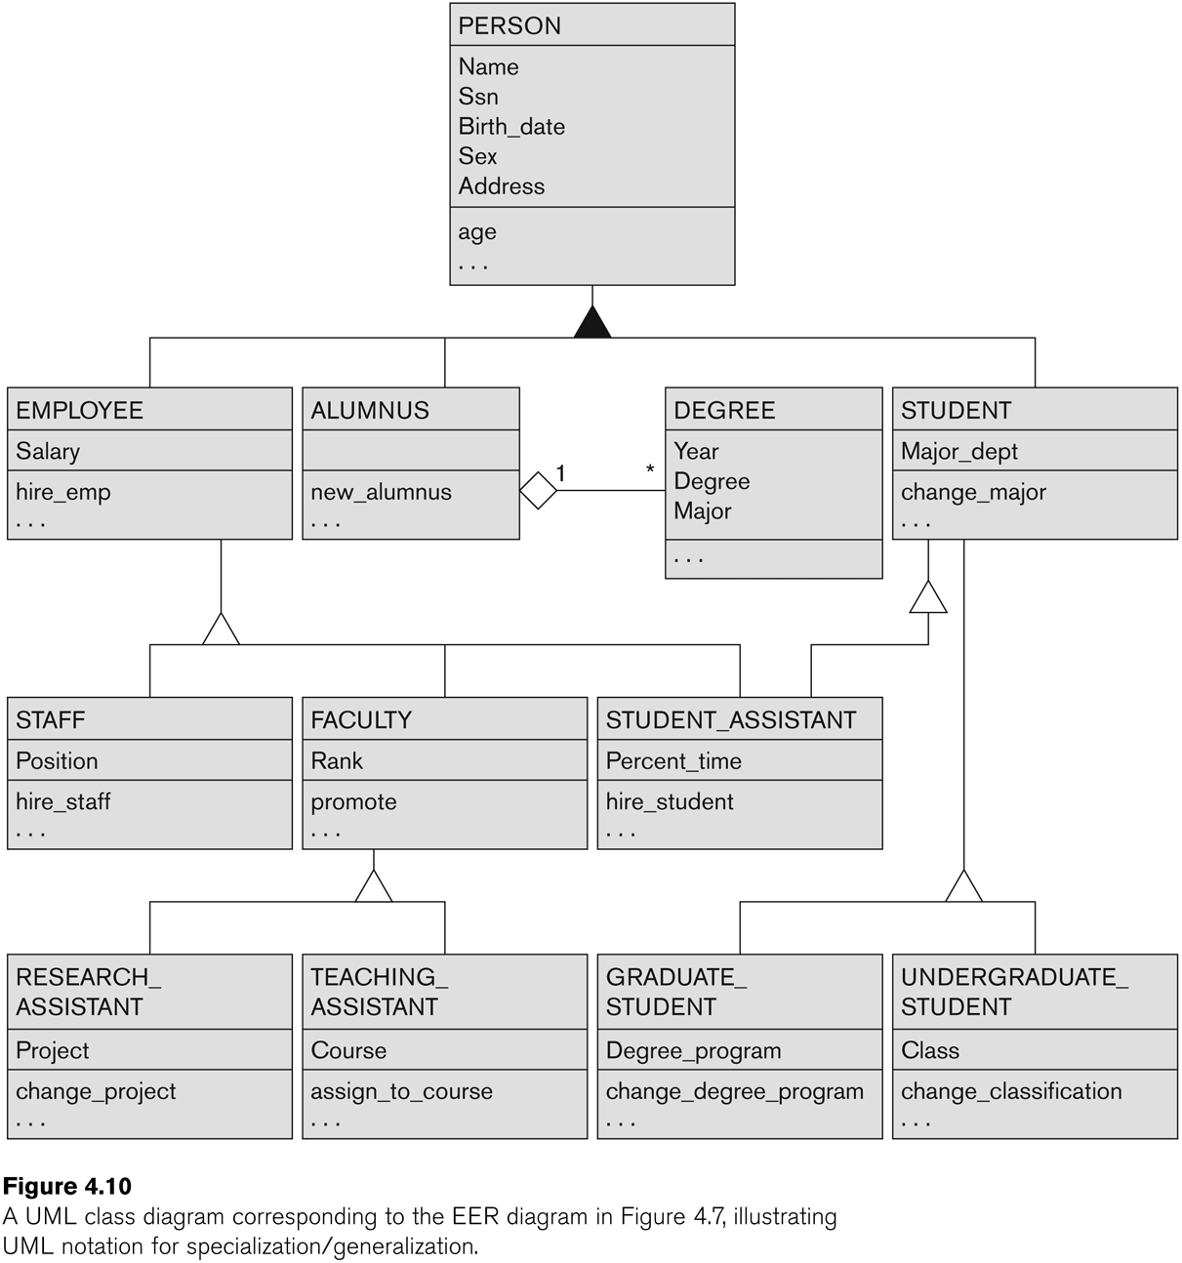
UML Example for Displaying Specialization / Generalization

Slide 95
Alternative Diagrammatic Notations

Slide 96
Knowledge Representation (KR)-1
Deals with modeling and representing a certain domain of knowledge.
Typically done by using some formal model of representation and by creating an Ontology
An ontology for a specific domain of interest describes a set of concepts and interrelationships among those concepts
An Ontology serves as a “schema” which enables interpretation of the knowledge in a “knowledge-base”

Slide 97
Knowledge Representation (KR)-2
COMMON FEATURES between KR and Data Models:
Both use similar set of abstractions – classification, aggregation, generalization, and identification.
Both provide concepts, relationships, constraints, operations and languages to represent knowledge and model data

Slide 98
Knowledge Representation (KR)-3
DIFFERENCES:
KR has broader scope: tries to deal with missing and incomplete knowledge, default and common-sense knowledge etc.
KR schemes typically include rules and reasoning mechanisms for inferencing
Most KR techniques involve data and metadata. In data modeling, these are treated separately
KR is used in conjunction with artificial intelligence systems to do decision support applications
For more details on spatial, temporal and multimedia data modeling, see Chapter 26. For details on use of Ontologies see Sections 27.4.3 and 27.7.4.

Slide 99
General Basis for Conceptual Modeling
TYPES OF DATA ABSTRACTIONS
CLASSIFICATION and INSTANTIATION
AGGREGATION and ASSOCIATION (relationships)
GENERALIZATION and SPECIALIZATION
IDENTIFICATION
CONSTRAINTS
CARDINALITY (Min and Max)
COVERAGE (Total vs. Partial, and Exclusive (Disjoint) vs. Overlapping)

Slide 100
Ontologies
Use conceptual modeling and other tools to develop “a specification of a conceptualization”
Specification refers to the language and vocabulary (data model concepts) used
Conceptualization refers to the description (schema) of the concepts of a particular field of knowledge and the relationships among these concepts
Many medical, scientific, and engineering ontologies are being developed as a means of standardizing concepts and terminology

Slide 101
Summary
Introduced the EER model concepts
Class/subclass relationships
Specialization and generalization
Inheritance
Constraints on EER schemas
These augment the basic ER model concepts introduced in Chapter 3
EER diagrams and alternative notations were presented
Knowledge Representation and Ontologies were introduced and compared with Data Modeling

